Slide 1
Powerpoint goes
Among Us
Tobias Krah # schule-digital.com

Slide 4
Emergency meeting

Slide 5
admin
card

Slide 6
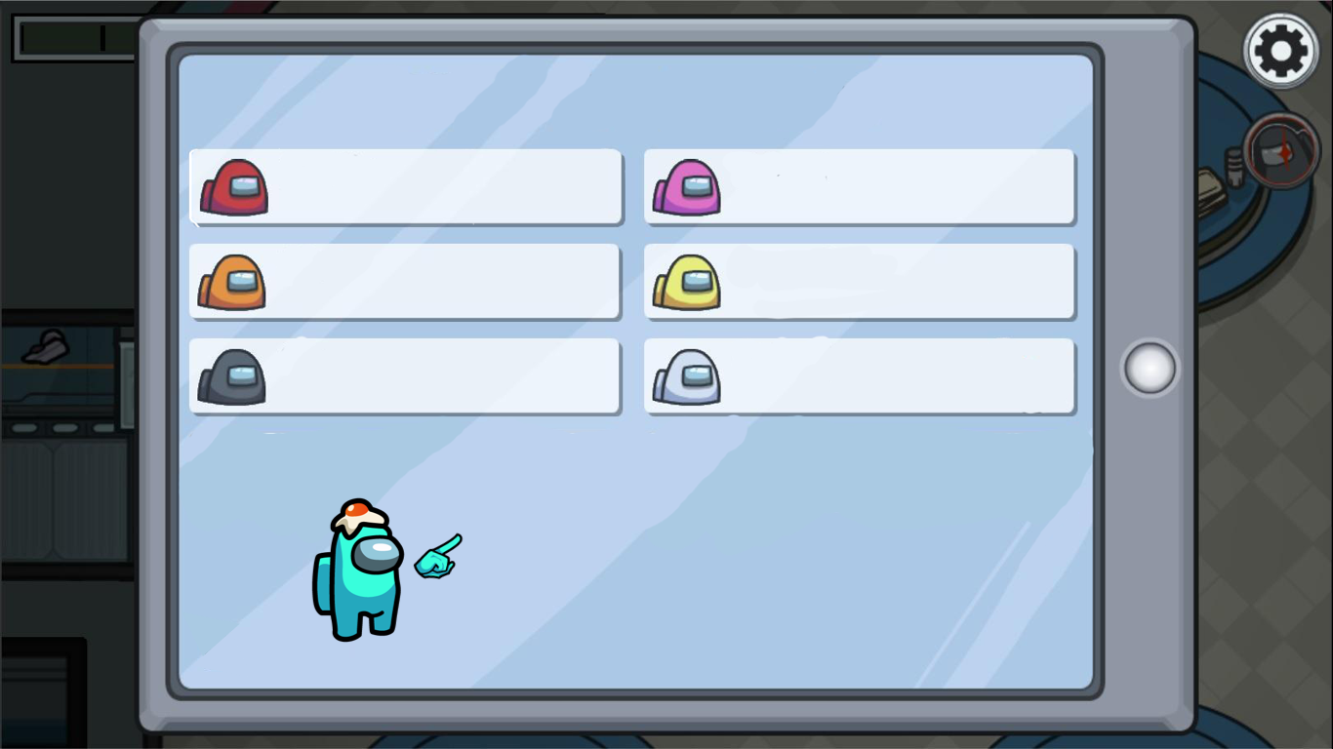
Name 1
Name 4
Name 2
Name 5
Name 3
Name 6

